Slide 1
Backup slides

Slide 2
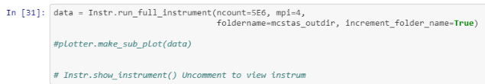
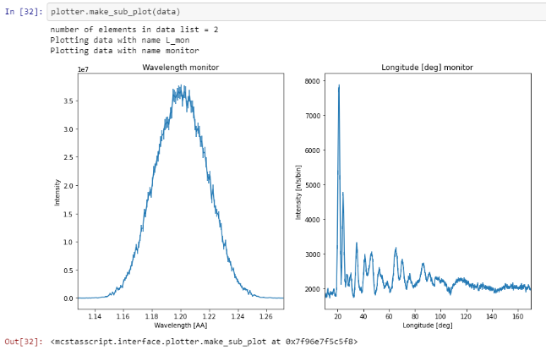
Examples
Jupyter notebook services
X-ray diffraction experiments at Free Electron Lasers
X-ray diffraction experiments at Synchrotrons
Density Functional Theory Target simulations
Neutron diffraction at conventional neutron sources

Slide 3
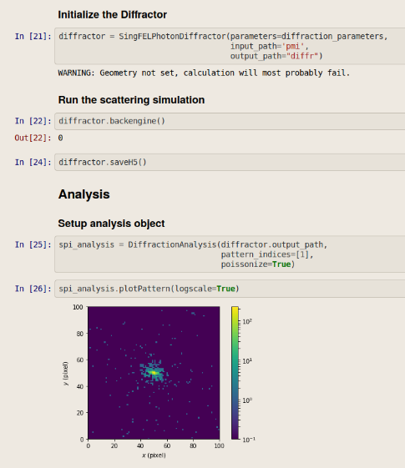
Examples
Jupyter notebook services
X-ray diffraction experiments at Free Electron Lasers

Slide 4
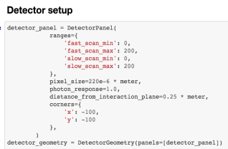
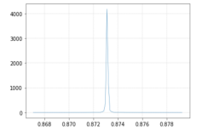
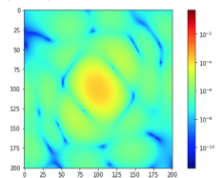


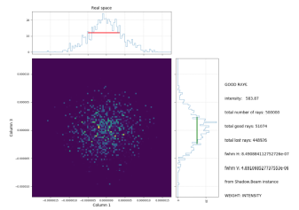
Examples
Jupyter notebook services
X-ray diffraction experiments at Free Electron Lasers
X-ray diffraction experiments at Synchrotrons

Slide 5
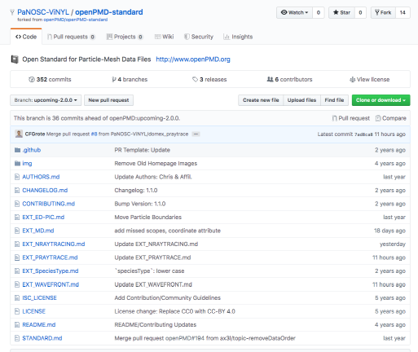
D5.1: openPMD domain extensions
https://github.com/PaNOSC-ViNYL/openPMD-standard/tree/upcoming-2.0.0
OpenPMD domain extensions for:
  Molecular Dynamics Simulation
  Neutron raytracing
  Photon raytracing
  Coherent Wavefront Propagation
Integration into openPMI standard ongoing (→ KPIs)

Slide 6
SimEx in ViNYL-project
In collaboration with WP4, we are preparing a serial crystallography example using SimEx to demonstrate the possibility of enabling users to rapidly implement simulations (WP5) and test the data analysis workflow (WP4)
To harmonize different simulation frameworks under one abstract pyvinyl API, we had a successful practice to bring the SimEx photon simulation framework and OASYS optical simulation environment together

Slide 7
SimEx: start to end simulations
Photon source
FEL
Synchrotron
Optical Laser
Photon propagation
Wave optics
Ray optics
Hybrid
Photon-Matter Interaction
Molecular Dynamics
Particle-In-Cell
Radiation-Hydrodynamics
Source radiation field
Focus radiation field
Sample trajectory
Electronic structure
Atom positions
Density, temperature, pressure
Data analysis
Structure solving
Dynamics
Thermodynamics
Detector
Pixel detector
Signal generation
Scattering
Absorption
Emission
Results
Detector response
Ideal Signal
Scattered light intensity
Secondaries (e⁻, ions)
Calculators: python APIs to advanced simulation codes
Data interfaces based on open metadata standards: openPMD

Slide 8
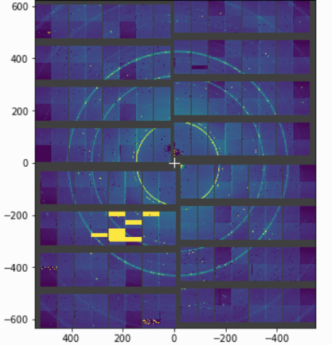
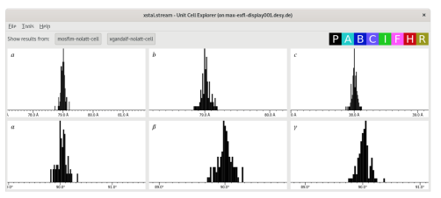
Serial Crystallography Simulation and Analysis
Demonstrate the effects of noise, panel gaps and masks on the results of crystallography analysis with SimEx simulation diffraction pattern results
Panel gaps
Masks
Scenarios:
New researchers want to get hands-on experience of data processing for serial crystallography.
Starting from a working example of a simulation coupled to an analysis pipeline
Explore how different experimental conditions and different analysis options affect the results.
Noise

Slide 9
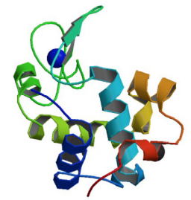
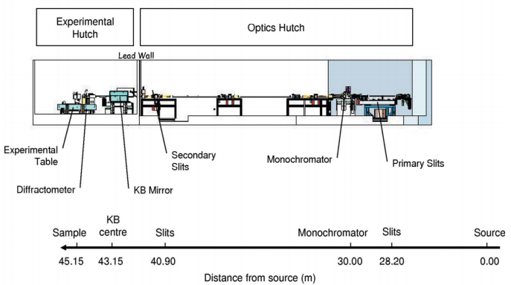
Polychromatic x-ray diffraction from lysozyme crystals at the ESRF
Lyzozyme

Slide 10
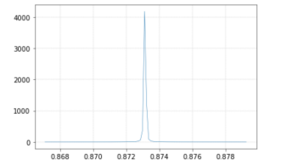

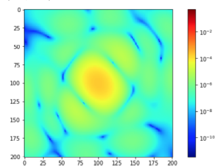
Polychromatic x-ray diffraction from lyzozyme crystals at the ESRF
OASYS
SimEx

Slide 11


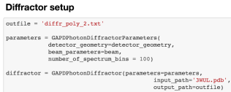
Polychromatic x-ray diffraction from lyzozyme crystals at the ESRF
Interface: Jupyter notebook
Simulation:
Setup detector parameters
Read raytracing output generated by OASYS
Setup diffractor parameters
Run the diffraction backengine
A good practice to bring a harmonized API
SimEx

Slide 12
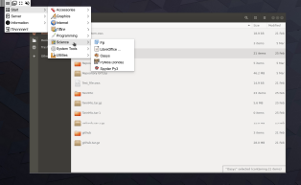
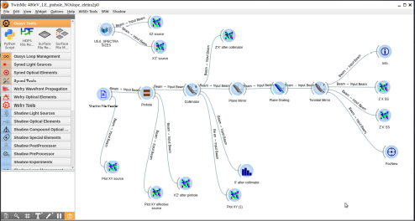
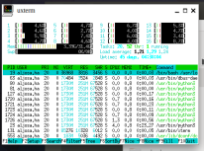
Remote access - RAFEC
RAFEC – internally developed remote access technology built around Xpra and Kubernetes
To be available through VUO
Collaborative access

Slide 13

McStasScript
McStas is a Monte Carlo neutron raytracing simulation tool
Used at almost all neutron sources in the world for instrument design
Written in C, user writes simulation in meta c language
Selected to be included in PaNOSC harmonized simulation package
Necessary to make a python API before this can happen, McStasScript
McStas simulation from source to detector including guide, chopper, sample environment and sample.

Slide 14
McStasScript
McStasScript
Python API
Python McStas API
  Traditional Python advantages
  Run McStas in Jupyter Notebook
  More choice in code placement
Local components
Produced data
Generate instrument file
Instrument file
c file
Executable
Reads the local components
Handles compilation / execution
Handles import of data
McStas
compiler
Users
c - compiler

Slide 15
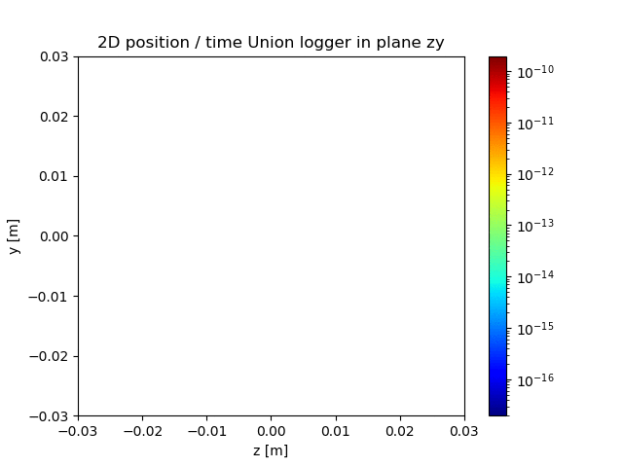
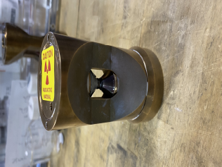
McStasScript
Diamond anvil
McStas simulation performed with McStasScriot Diamond anvil
Scattered intensity
Used at experiment @ SNS, Tennessee
  Simulated diamond anvil and sample
  Improved flexibility with python interface
  Faster to implement changes in experimental setup
  Data still being analyzed

Slide 16
Materials Simulations through common platform for PaNOSC
Mousumi Upadhyay Kahaly, Computational Materials Science, Theory & Simulation, ELI-ALPS, Szeged, Hungary
WP5 ViNYL: Top level components
SIMEX
MCSTAS/ Mcstas script
ASE
OASYS
Current involvement from ELI-ALPS
Work plan for WP5 – part 1:
Running materials simulations through a common platform, for users
Convert the relaxed structure into format required by the subsequent simulation step (either neutron scattering or x-ray absorption)
Deposit the final relaxed structure and on the NOMAD database (make an account for ViNYL)

Slide 17
https://github.com/PaNOSC-ViNYL/
workshop2020/blob/team2/demo/team2/ase.ipynb
Highlights of achievements so far:
  Running a structural relaxation, energy/force minimization with a DFT or TDDFT calculator within a common Atomistic simulation environment (ASE).
  Devise a workflow where data is split up into metadata (including the input parameters), raw data (sim. output), and reduced/analyzed data.
  Feeding DFT output structures to MCSTAS and simulating signals.
  Defining and implementing python classes which allows us to describe different stages of the interaction as well defined objects.
  A Jupyter notebook is prepared that represents an example of the possible work-flow : structural relaxation → photon-matter or neutron-matter interaction → simulation of signal.

Slide 18
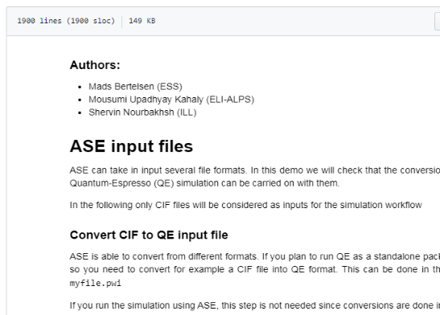
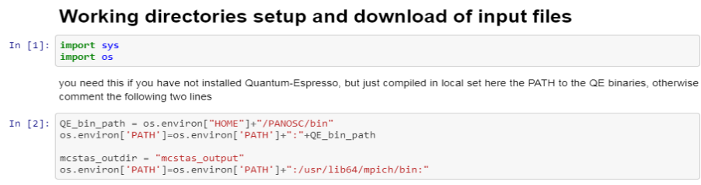
https://github.com/PaNOSC-ViNYL/workshop2020/blob/team2/demo/team2/ase.ipynb

Slide 19
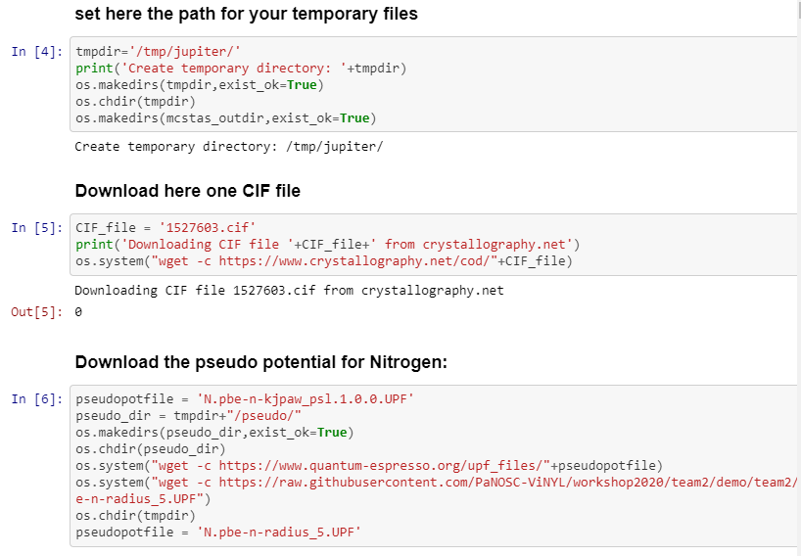
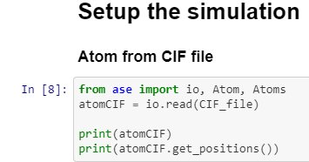
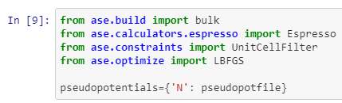
Importing relevant tools
Goes on…

Slide 20



DFT output structures fed into MCSTAS and simulating signals
https://github.com/PaNOSC-ViNYL/workshop2020/blob/team2/demo/team2/ase.ipynb

Slide 21
Laser-driven high repetition rate neutron sources at ELI-ALPS
Zsolt Lécz, Plasma Physics Group, ELI-ALPS, Szeged, Hungary
The plan for WP5 – part 2:
- production of neutrons with energy higher than ~MeV.
The production rate should be >10^12/s
- these neutrons will be used for transmutation: nuclear reaction in order to reduce the lifetime of nuclear waste and to make them less radioactive.
- for producing high energy neutrons we need energetic ions first. One possible reaction candidate: D+D = He + n(2.45 MeV)
- high repetition rate lasers are needed to achieve the desired production rate
First steps:
- Study experimentally and theoretically the ion acceleration with the SYLOS laser shooting on micrometer thin aluminum foils
- Calculate the approximated neutron number using the typical proton energy distribution (assuming that they are deuteron)
- currently we estimate 10^10 neutrons/ second

Slide 22
Highlights of achievements:
  Implementation of a simple Monte-Carlo algorithm for generating the neutron distribution which is created from D+D reactions
  Implementation of Python classes which allows us to describe different stages of the interaction as well defined objects
  A Jupyter notebook represents an example of the possible work-flow : ion acceleration → ion-matter interaction → neutron data
https://github.com/PaNOSC-ViNYL/neutrontools/blob/master/Test2.ipynb

Slide 23
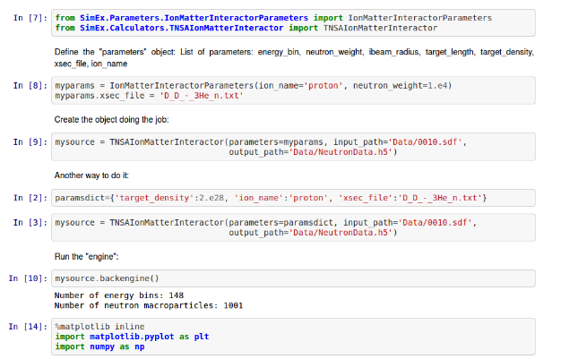
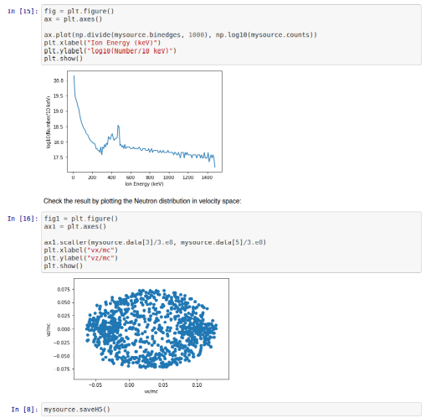
Jupyter notebook presenting the example workflow:
Ion energy spectrum
The code uses the ion spectra obtained from PIC simulations and generates the neutron data, which is saved in hdf format.
Generated neutrons in velocity space

Slide 24
Next step: make it compatible with high rep-rate lasers using spray targets
Target
~1 mm width
100-500 keV deuteron ions are generated.
30 mJ, 10 fs laser pulses @ 1 kHz repetition rate
Reaction: D(1,2)+D(1,2)=He(2,3)+n
Flow of heavy water droplets
Water droplets (about 100 nm size) expand or explode
Outlook:
- implementation of a kinetic approach in the base algorithm of the code, which takes into account the ion momentum distribution and their spatial distribution.
- incorporate it in PanOSC-Vynil

Slide 25
Thank you

